Slide 1


BMS INSTITUTE OF TECHNOLOGY AND MANAGEMENT
Internship Presentation – 18CSI85
On
Design of a class room application
Presented By
Mr. Prakhyat USN:1BY18CS108
Web Development Intern at Infidata Technologies
Under the guidance of
Prof. Durga Bhavani A
Dept. of CSE, BMSIT

Slide 2
BMS INSTITUTE OF TECHNOLOGY AND MANAGEMENT
Contents
Abstract
About InfiData Technologies
Product and Services
Internship Domain
Activities
Tasks Performed
Outcomes

Slide 3
Abstract
Traditional assignment management is becoming obsolete due to its inconvenience,
inefficiency, and low accuracy. Currently, web-based management systems have been
widely implemented due to the development of Web and CGI technologies. This project
introduces a new web-based Assignment Management System, which combines all useful
features in other commercial systems and implements new functions that are practical in
assignment management. Its powerful features and friendly user interfaces allow
instructors and students to handle their assignments in a convenient, efficient, and
systematical way. In addition, this system also has very good portability and extensibility,
and the system security has been strongly enhanced by multiple security strategies.

Slide 4

BMS INSTITUTE OF TECHNOLOGY AND MANAGEMENT
About InfiData Technologies
InfiData is an IT Training & Software Development Centre In Bangalore.
InfiData Technologies An ISO 9001:2015 Certified IT Company, Accredited by An International Accreditation Service (IAS). Head quartered in "silicon valley" of India Bengaluru, started in the year 2015. We are highly specialized in the design and development of websites, software application development, mobile app development,
E-Commerce solutions and more. Our team of expert professionals works on the latest software tools and technologies to give the best and promising services to our customers.

Slide 5
BMS INSTITUTE OF TECHNOLOGY AND MANAGEMENT
Vision
To become a leading performer and grow as a major IT service provider, in providing quality Web application, Software Development solutions and corporate training in the competitive global marketplace.
Mission
To ensure strategic planning with quality products and Profitable growth through customer service, innovation, quality and commitment.

Slide 6
BMS INSTITUTE OF TECHNOLOGY AND MANAGEMENT
Product and Services
Company Products:
ECAMS
Billing Software
ERP Solution
Retail Store

Slide 7
BMS INSTITUTE OF TECHNOLOGY AND MANAGEMENT
Product and Services
Infidata Services:
Infidata Technologies offer the services in the following areas:
Enterprise Application Services
Web designing and Development
Mobile Application Development
Internet of Things
Training Services

Slide 8
BMS INSTITUTE OF TECHNOLOGY AND MANAGEMENT
Infidata Clients:
Streams Inc
Vishnu Enterprises
JB Transport India
Break DQ
Rbits Technologies

Slide 9
BMS INSTITUTE OF TECHNOLOGY AND MANAGEMENT
INTERNSHIP DOMAIN
Introduction
A “Web Application Development” is a client–server software application in which the client (or user interface) runs in a web browser. Common web application include email, online retail sales, online auctions, wikis, instant messaging services and many other functions.
Web Application Development is the creation of application programs that reside on remote servers and are delivered to the user's device over the Internet.
They work in a variety of organizations of any size, and some work as independent freelancers. The creation of a Web Application usually involves one or more Developers.

Slide 10
BMS INSTITUTE OF TECHNOLOGY AND MANAGEMENT
Tools & Technologies Used during Training:
HTML and CSS
Java Script
Bootstrap Framework
PHP
MySQL
jQuery
Angular JS
MongoDB

Slide 11
BMS INSTITUTE OF TECHNOLOGY AND MANAGEMENT
ACTIVATES DURING INTERNSHIP
Week 1 Activities
• Domain Training
• Training on HTML and CSS Assignments
• Case Study Activities
Week 2 Activities
• Training on SDLC, Bootstrap & CSS
• Activities on Bootstrap & CSS

Slide 12
BMS INSTITUTE OF TECHNOLOGY AND MANAGEMENT
Week 3 Activities
• Project Analysis & Design
• Project Based Activities with team
• Training on Bootstrap & CSS
• Activities on JavaScript & Php
• Project Work
Week 4 Activities
• Project Based Activities with team
• Activities on JavaScript & jQuery
• Assessment Test
• Internship Project Work Presentation
• Internship Report Preparation

Slide 13
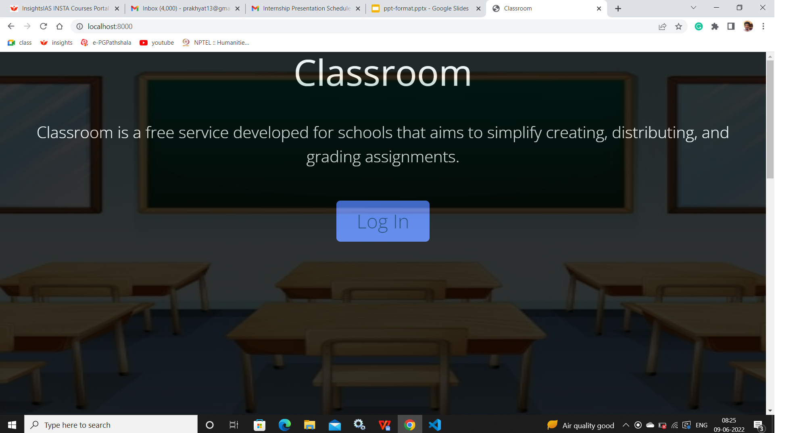
BMS INSTITUTE OF TECHNOLOGY AND MANAGEMENT
Tasks Performed
Design of class room web application
INTRODUCTION
In todays day and age of online learning, it is important to have an online platform such that students can submit their assignments, teachers can assess them and return back the results. Hence, we have made Classroom to accomplish this task.
System Actors (Users)
Teachers
Students
Admin Features
Teacher Login
Create classroom
Create assignments
Evaluate assignments

Slide 14
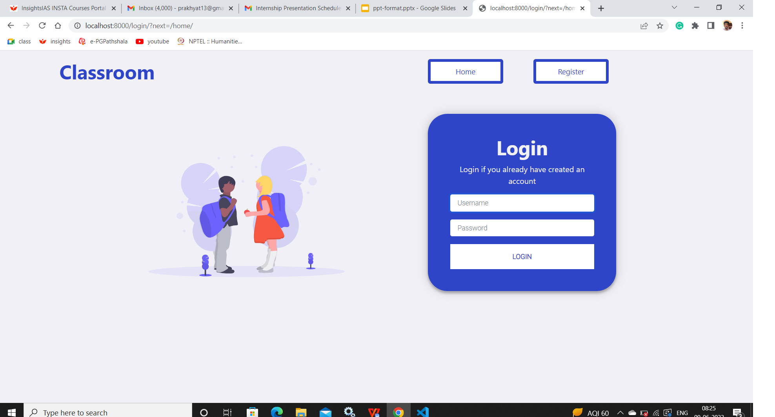
BMS INSTITUTE OF TECHNOLOGY AND MANAGEMENT
Students
Students login
Join class room
View and submit assignments
View marks
Software Requirements
Visual studio
Language Used
Front End (User Interface) HTML 5, JAVASCRIPT,
Server Language ASP.NET
Back End MySQL

Slide 15
BMS INSTITUTE OF TECHNOLOGY AND MANAGEMENT
Internship Outcomes
Explore career alternatives prior to graduation.
Integrate theory and practice.
Assess interests and abilities in their field of study.
Learn to appreciate work and its function in the economy.
Develop work habits and attitudes necessary for job success.
Develop communication, interpersonal and other critical skills in the job interview process.
Build a record of work experience.
Acquire employment contacts leading directly to a full-time job following graduation from college.

Slide 16
BMS INSTITUTE OF TECHNOLOGY AND MANAGEMENT
THANK YOU

